Slide 1


































Microsoft Azure Data Analytics Platform アーキテクチャ
Generate
Ingest
Store
Process
Enrich
Serve
Consume
On-Prems / Cloud
Realtime
Stream
Hot Path
IoT Hub
Batch
Functions
Power BI Premium
Dashboard
Event Hubs
Stream Analytics
Unstructured Semi Structured
Cognitive Services
Analytics
SQL Database
Relational
Dedicated SQL
Data Explorer
Machine Learning
Cold Path
Dataflow
Cosmos DB
Data-driven Applications
Pipeline
NoSQL
Serverless Spark
Serverless SQL
HTAP with Synapse Link
Data Lake
Data Share
Shared Datasets
Discover & Govern
Azure Purview
Azure Active Directory
Azure Cost Management
Azure Key Vault
Azure Security Center
Platform
Azure Monitor
Azure DevOps
GitHub
Azure Policy

Slide 2
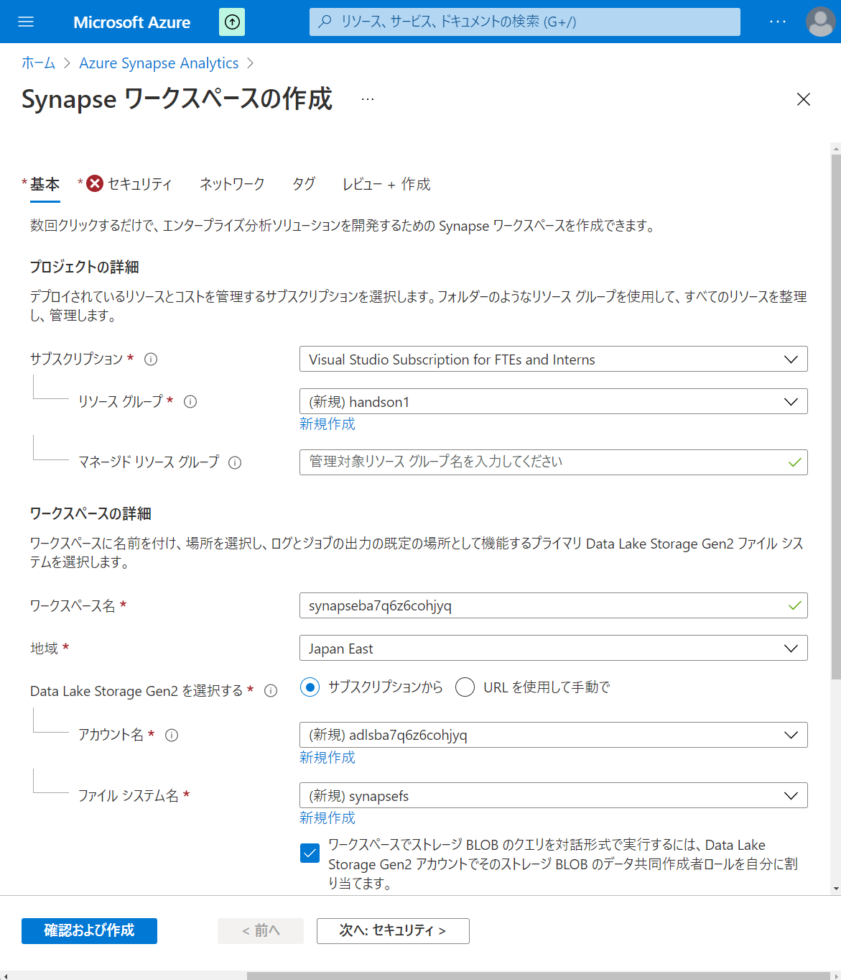

Slide 3
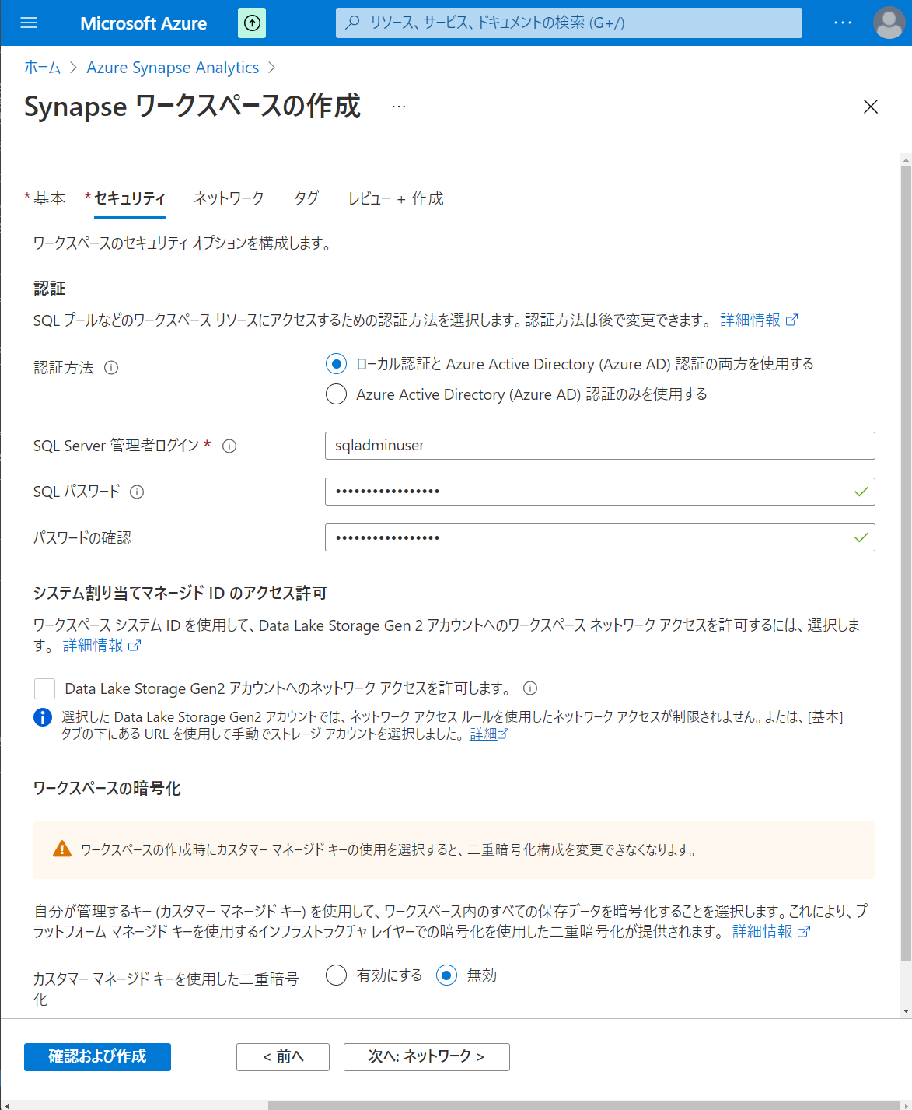

Slide 4
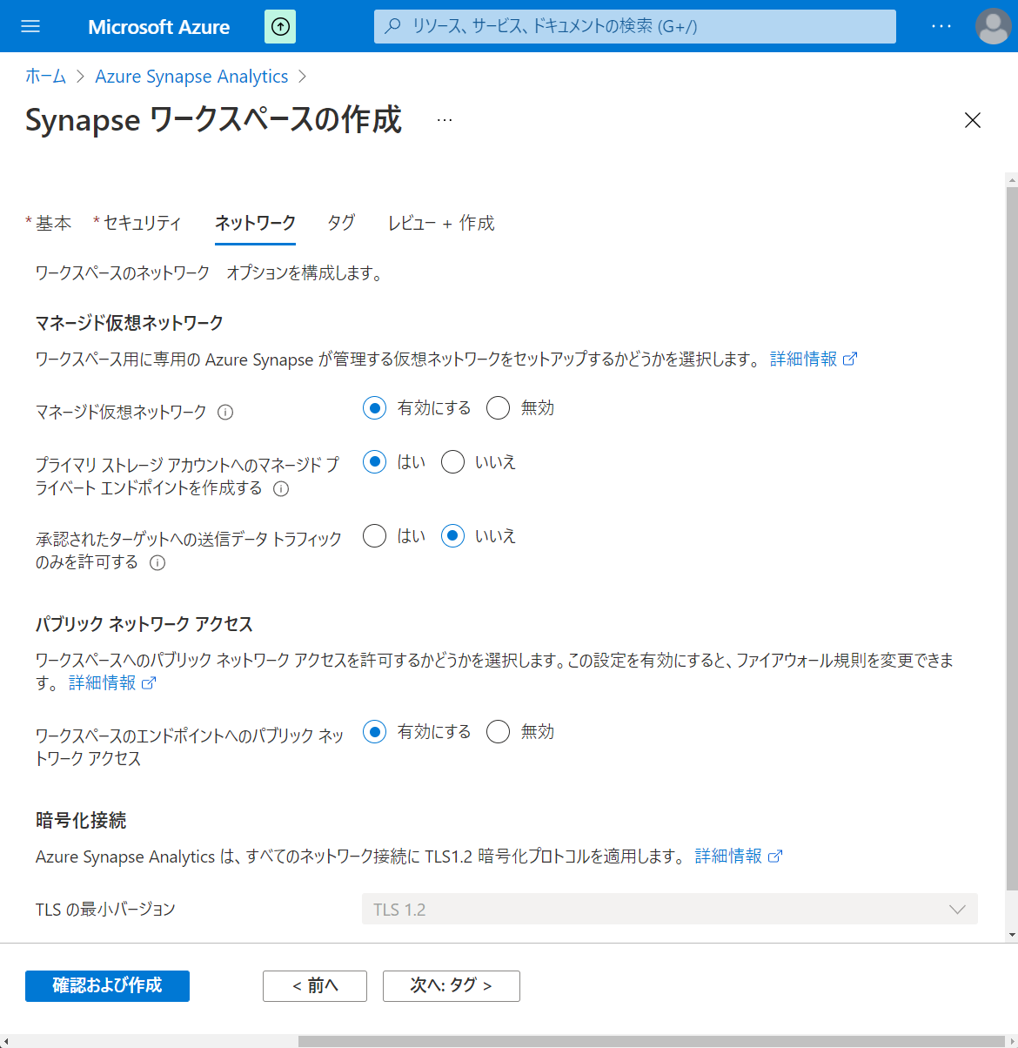

Slide 5
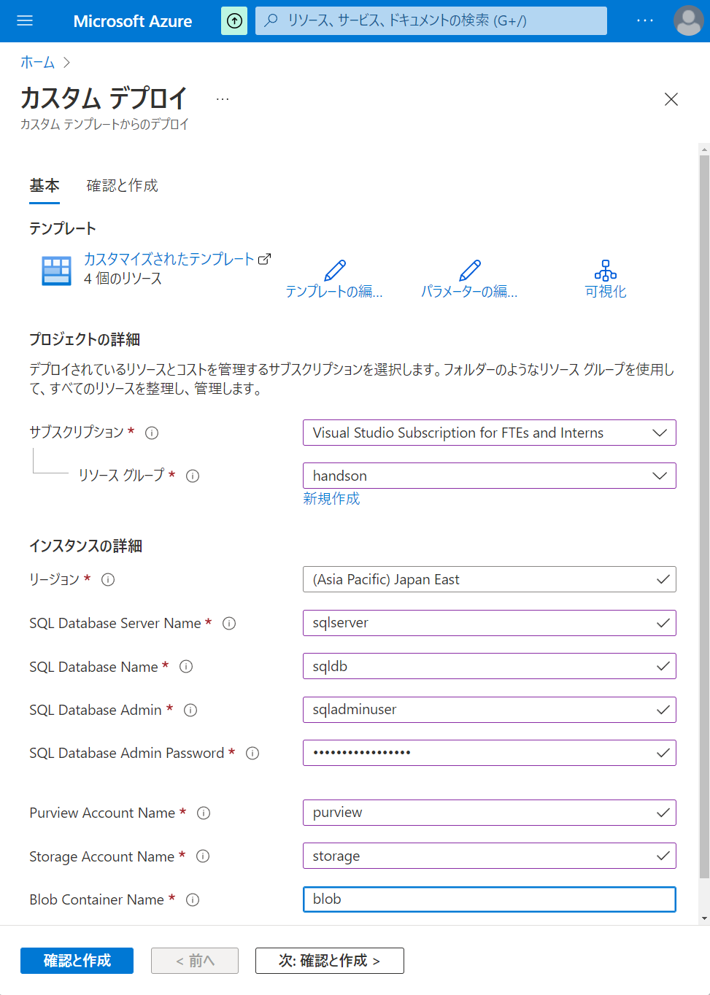

Slide 6
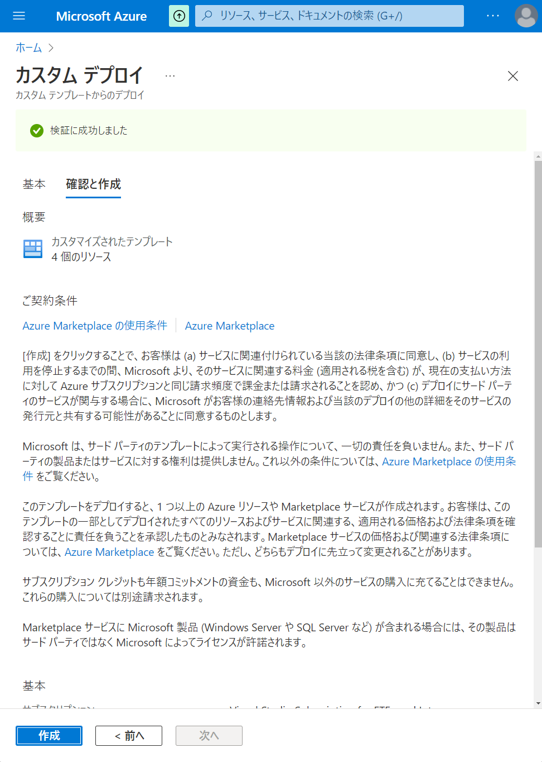

Slide 7
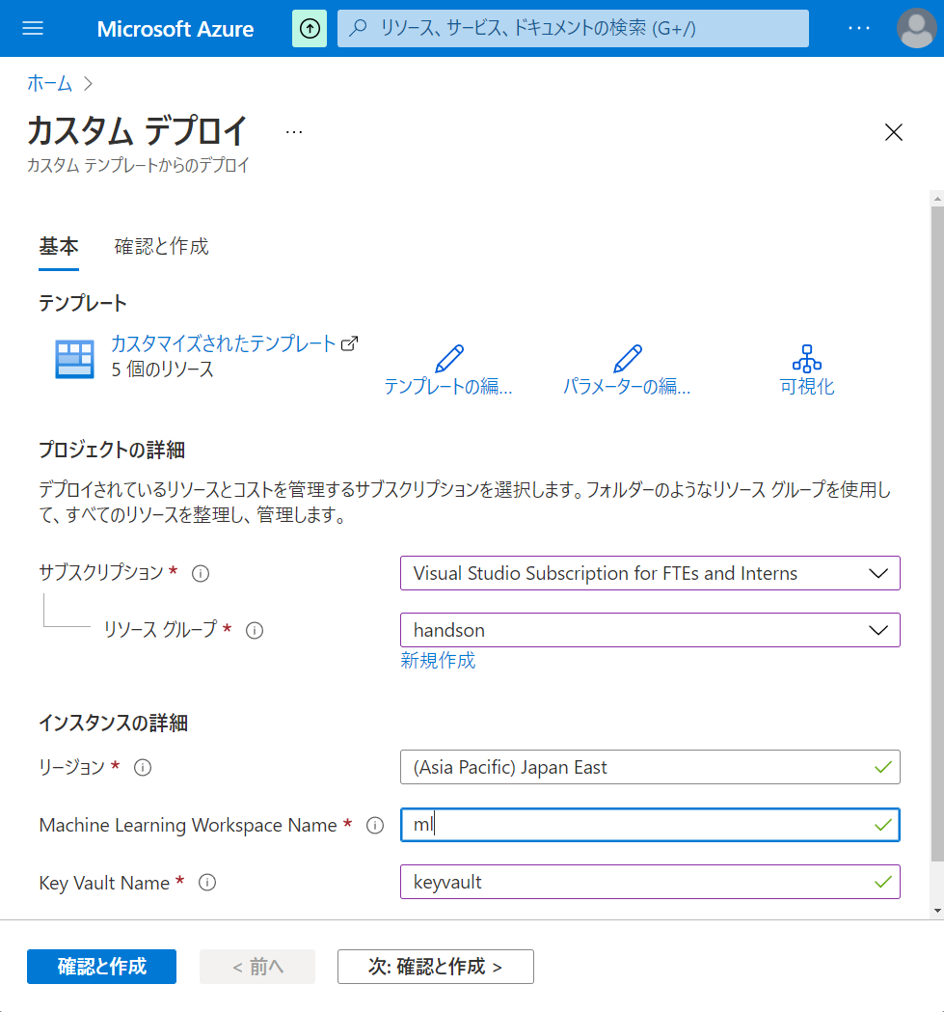

Slide 8
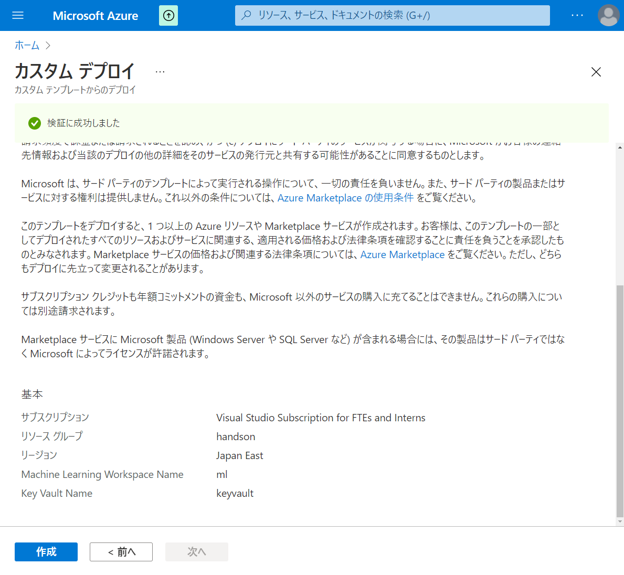

Slide 9
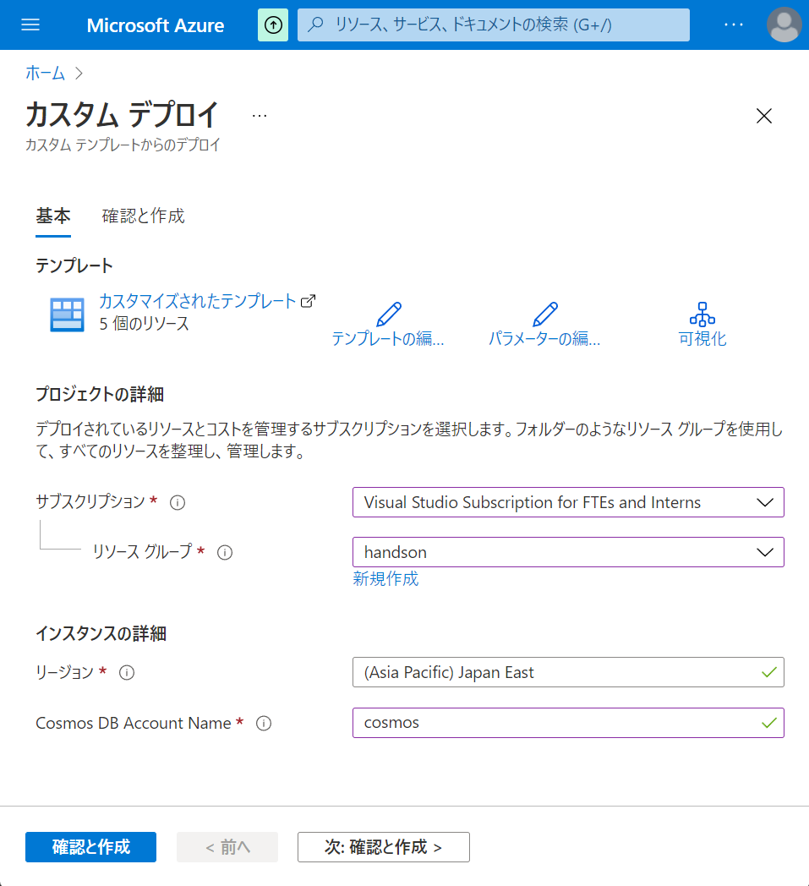

Slide 10
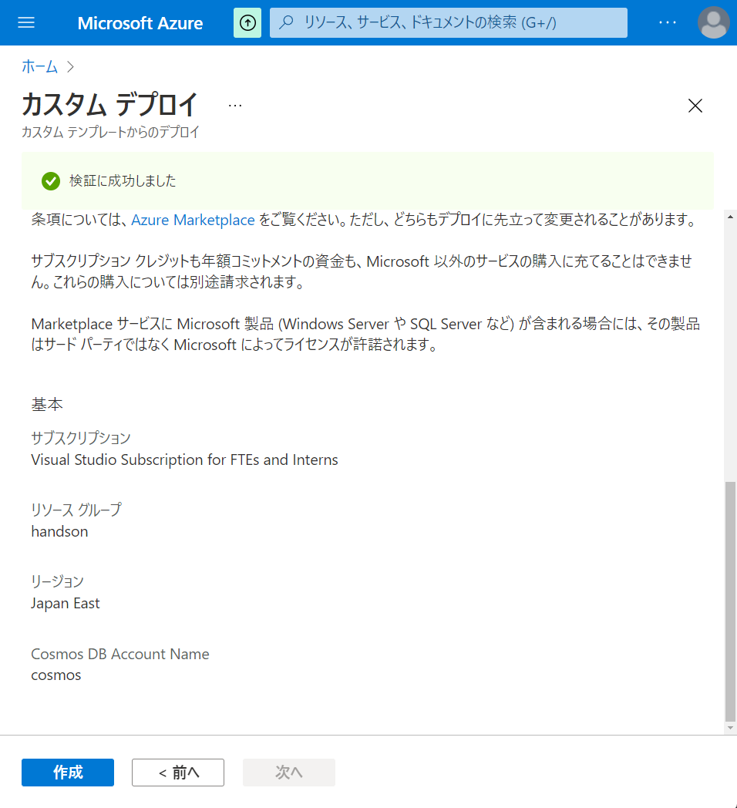

Slide 11
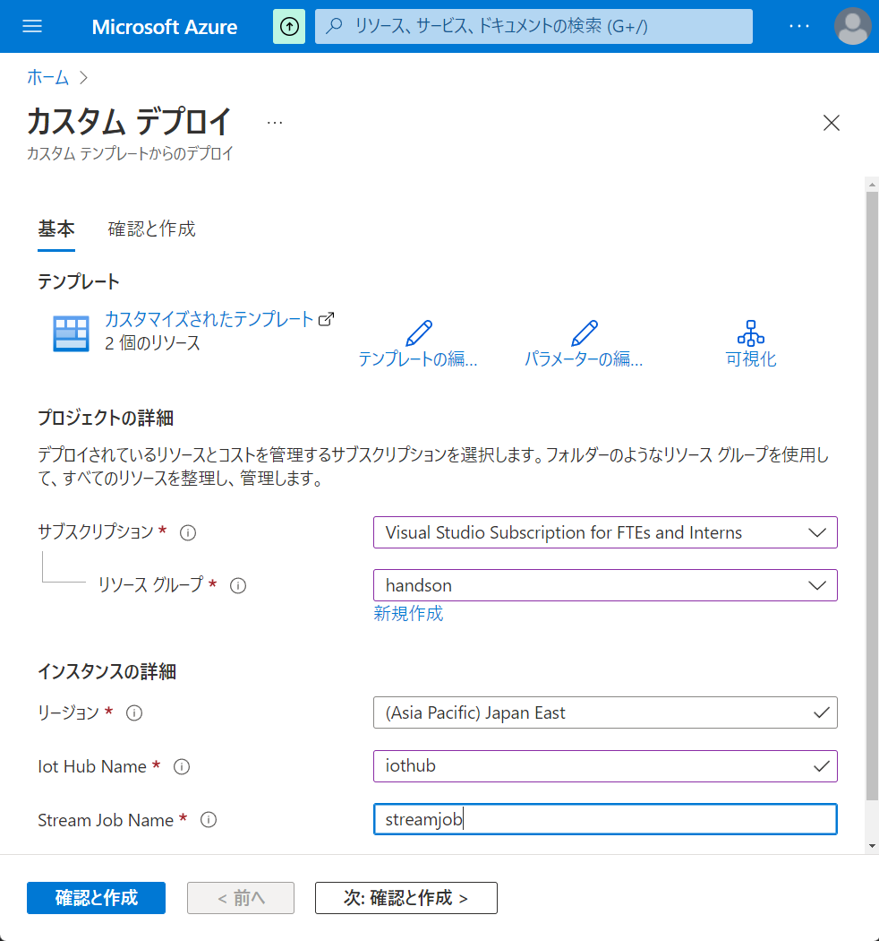

Slide 12
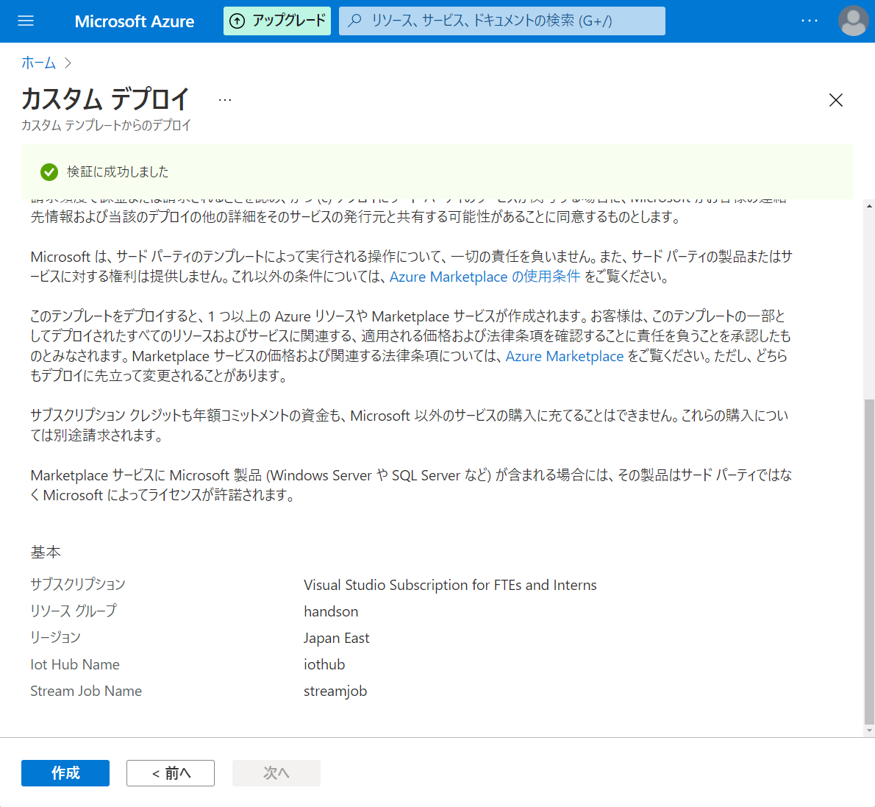

Slide 13
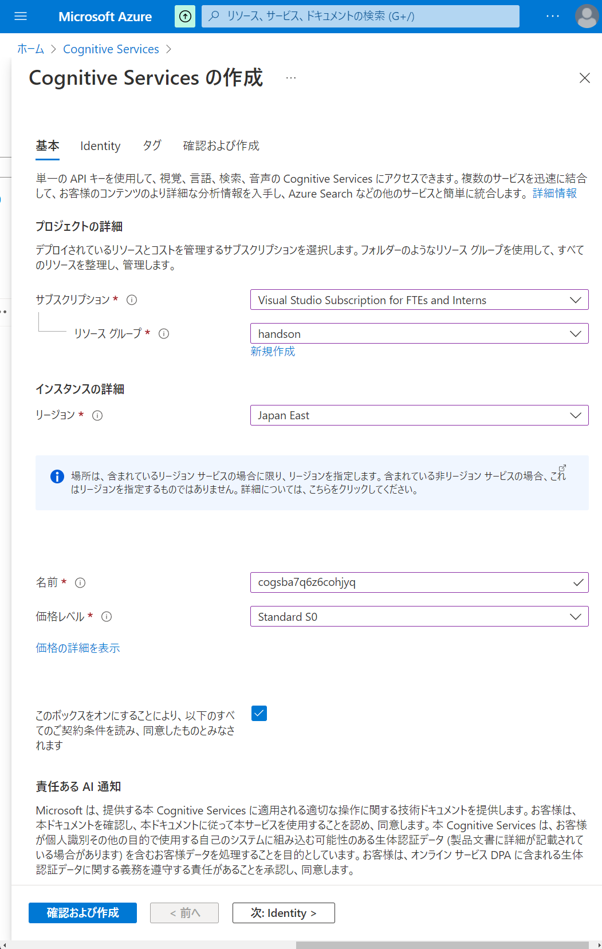

Slide 14
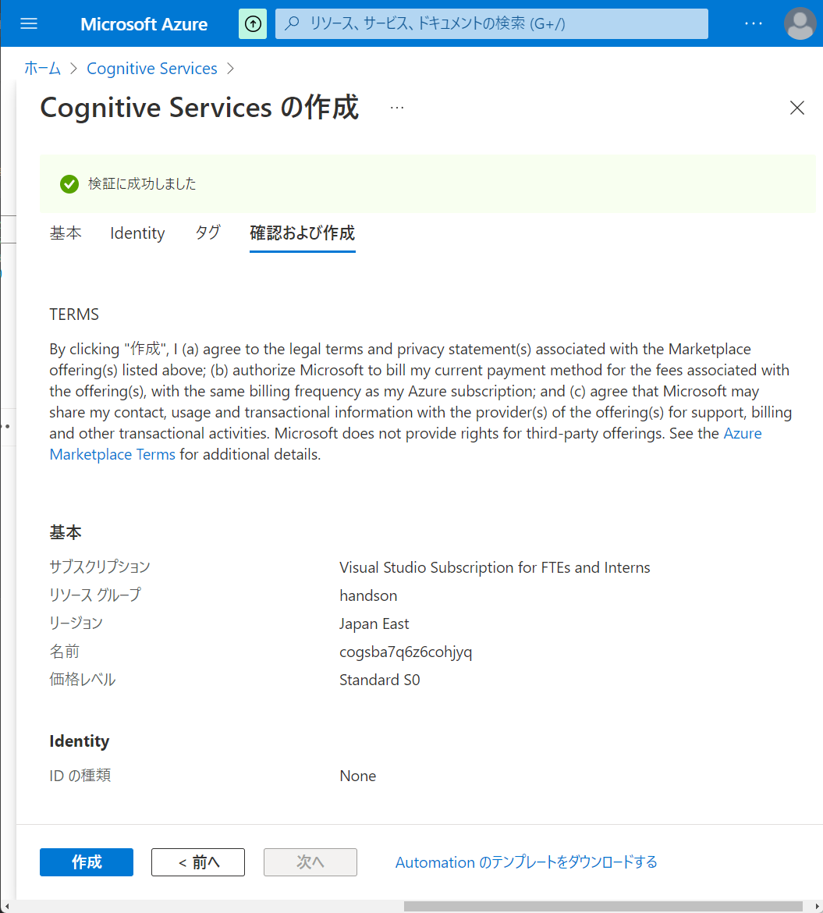

Slide 15
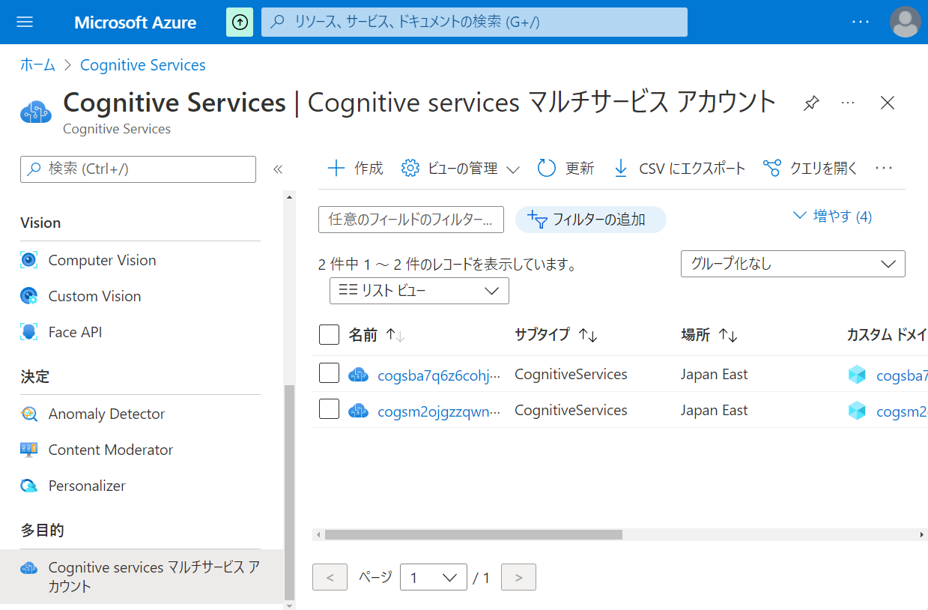

Slide 16
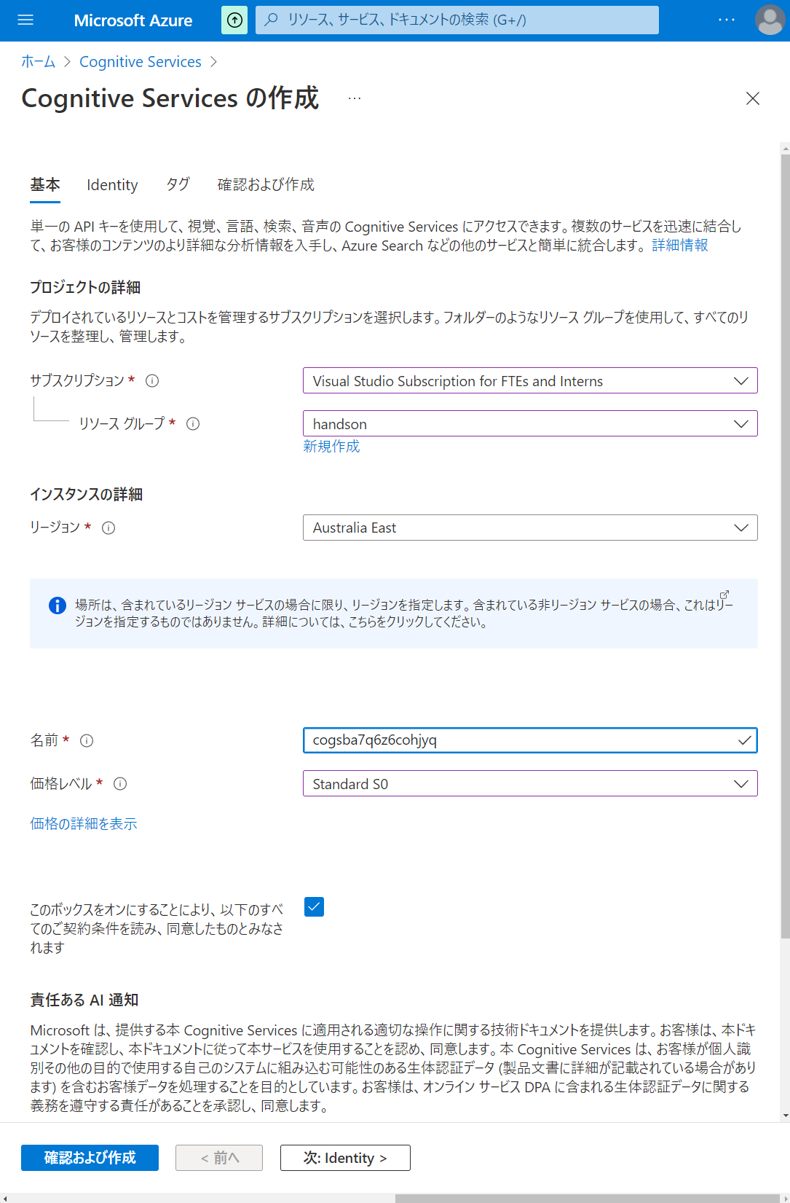

Slide 17


Slide 18
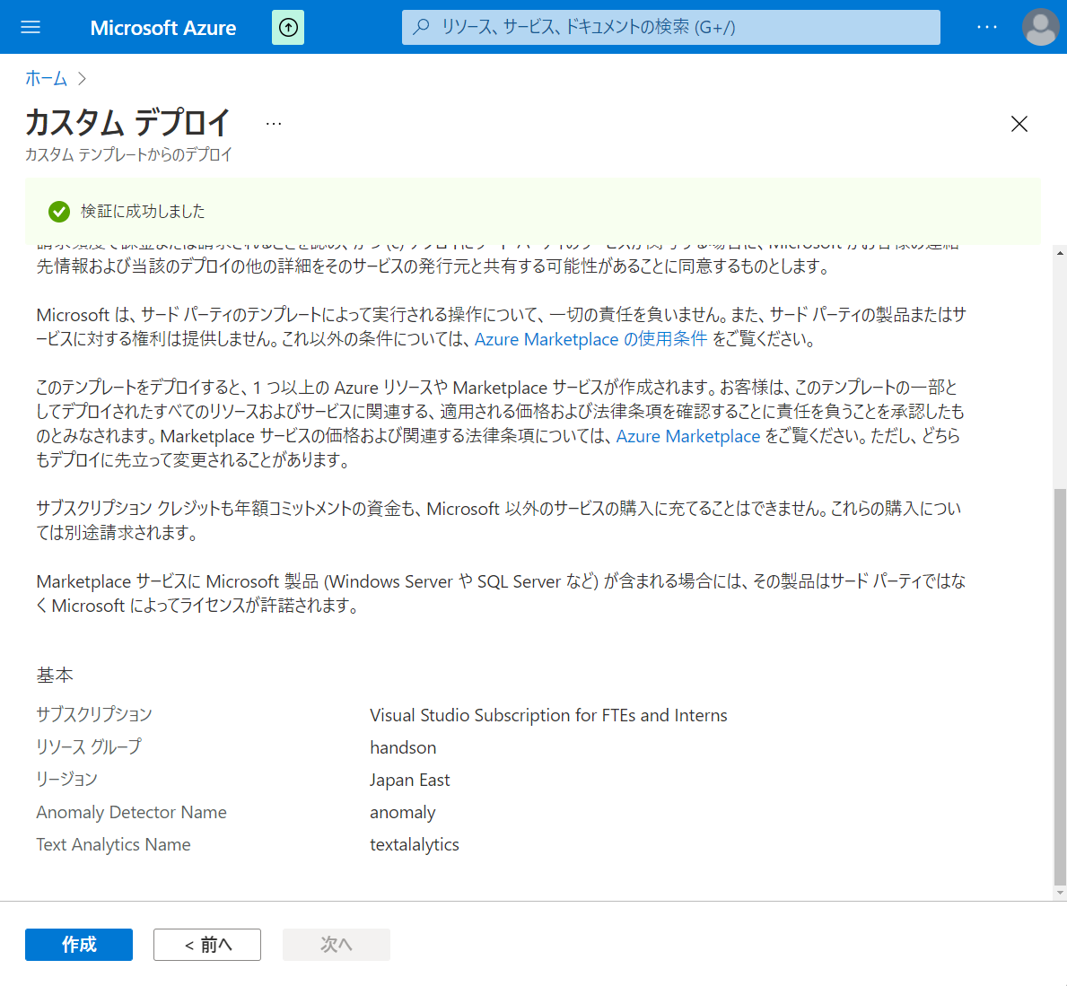

Slide 19
第5章：データの統合と可視化
Generate
Ingest
Store
Process
Enrich
Serve
Consume
On-Prems / Cloud
Realtime
Stream
Hot Path
IoT Hub
Batch
Functions
Power BI Premium
Dashboard
Event Hubs
Stream Analytics
Un/Semi -Structured
Cognitive Services
Analytics
SQL Database
Relational
Dedicated SQL
Data Explorer
Machine Learning
Cold Path
Dataflow
Cosmos DB
Data-driven Applications
Pipeline
NoSQL
Serverless Spark
Serverless SQL
HTAP with Synapse Link
Data Lake
Data Share
Shared Datasets
Discover & Govern
Azure Purview
Azure Active Directory
Azure Cost Management
Azure Key Vault
Azure Security Center
Platform
Azure Monitor
Azure DevOps
GitHub
Azure Policy

Slide 20
第6章：アドホックデータ探索とデータプレパレーション
Generate
Ingest
Store
Process
Enrich
Serve
Consume
On-Prems / Cloud
Realtime
Stream
Hot Path
IoT Hub
Batch
Functions
Power BI Premium
Dashboard
Event Hubs
Stream Analytics
Un/Semi -Structured
Cognitive Services
Analytics
SQL Database
Relational
Dedicated SQL
Data Explorer
Machine Learning
Cold Path
Dataflow
Cosmos DB
Data-driven Applications
Pipeline
NoSQL
Serverless Spark
Serverless SQL
HTAP with Synapse Link
Data Lake
Data Share
Shared Datasets
Discover & Govern
Azure Purview
Azure Active Directory
Azure Cost Management
Azure Key Vault
Azure Security Center
Platform
Azure Monitor
Azure DevOps
GitHub
Azure Policy

Slide 21
第7章：機械学習統合によるデータエンリッチメント
Generate
Ingest
Store
Process
Enrich
Serve
Consume
On-Prems / Cloud
Realtime
Stream
Hot Path
IoT Hub
Batch
Functions
Power BI Premium
Dashboard
Event Hubs
Stream Analytics
Un/Semi -Structured
Cognitive Services
Analytics
SQL Database
Relational
Dedicated SQL
Data Explorer
Machine Learning
Cold Path
Dataflow
Cosmos DB
Data-driven Applications
Pipeline
NoSQL
Serverless Spark
Serverless SQL
HTAP with Synapse Link
Data Lake
Data Share
Shared Datasets
Discover & Govern
Azure Purview
Azure Active Directory
Azure Cost Management
Azure Key Vault
Azure Security Center
Platform
Azure Monitor
Azure DevOps
GitHub
Azure Policy

Slide 22
第8章：リアルタイムデータ分析
Generate
Ingest
Store
Process
Enrich
Serve
Consume
On-Prems / Cloud
Realtime
Stream
Hot Path
IoT Hub
Batch
Functions
Power BI Premium
Dashboard
Event Hubs
Stream Analytics
Un/Semi -Structured
Cognitive Services
Analytics
SQL Database
Relational
Dedicated SQL
Data Explorer
Machine Learning
Cold Path
Dataflow
Cosmos DB
Data-driven Applications
Pipeline
NoSQL
Serverless Spark
Serverless SQL
HTAP with Synapse Link
Data Lake
Data Share
Shared Datasets
Discover & Govern
Azure Purview
Azure Active Directory
Azure Cost Management
Azure Key Vault
Azure Security Center
Platform
Azure Monitor
Azure DevOps
GitHub
Azure Policy

Slide 23
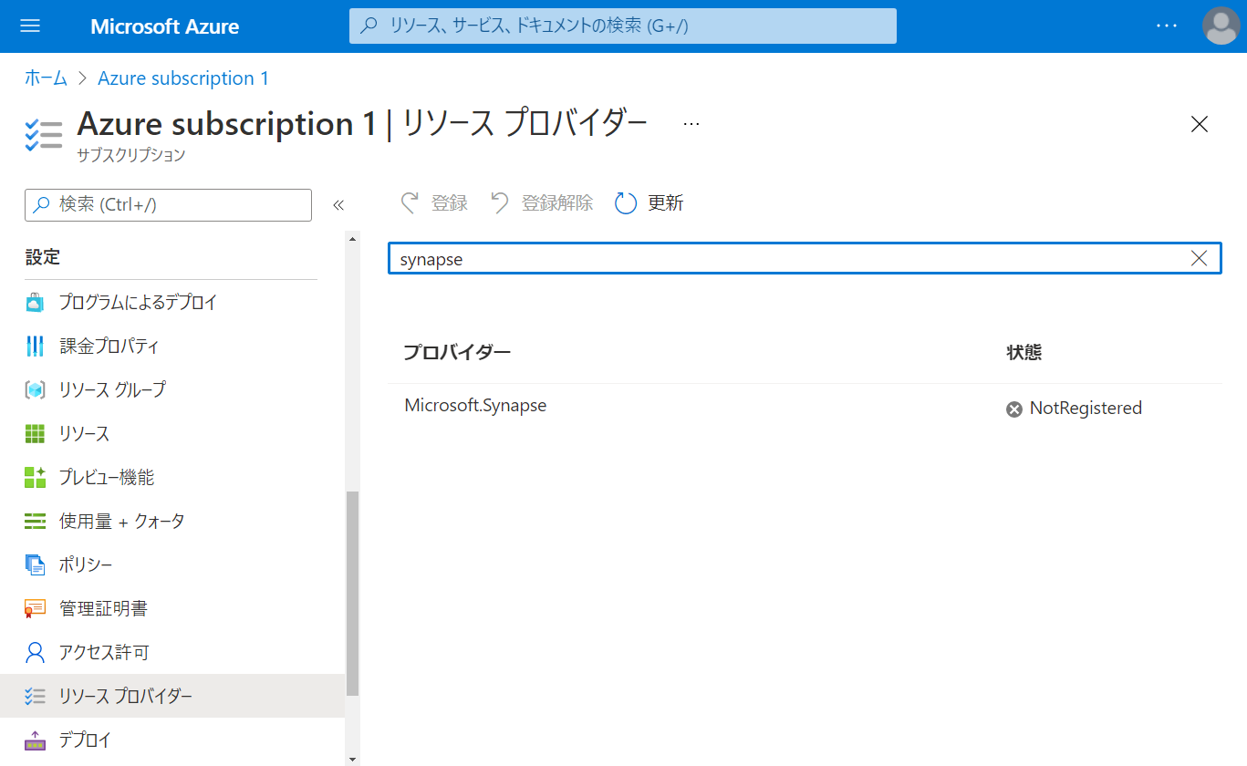

Slide 24
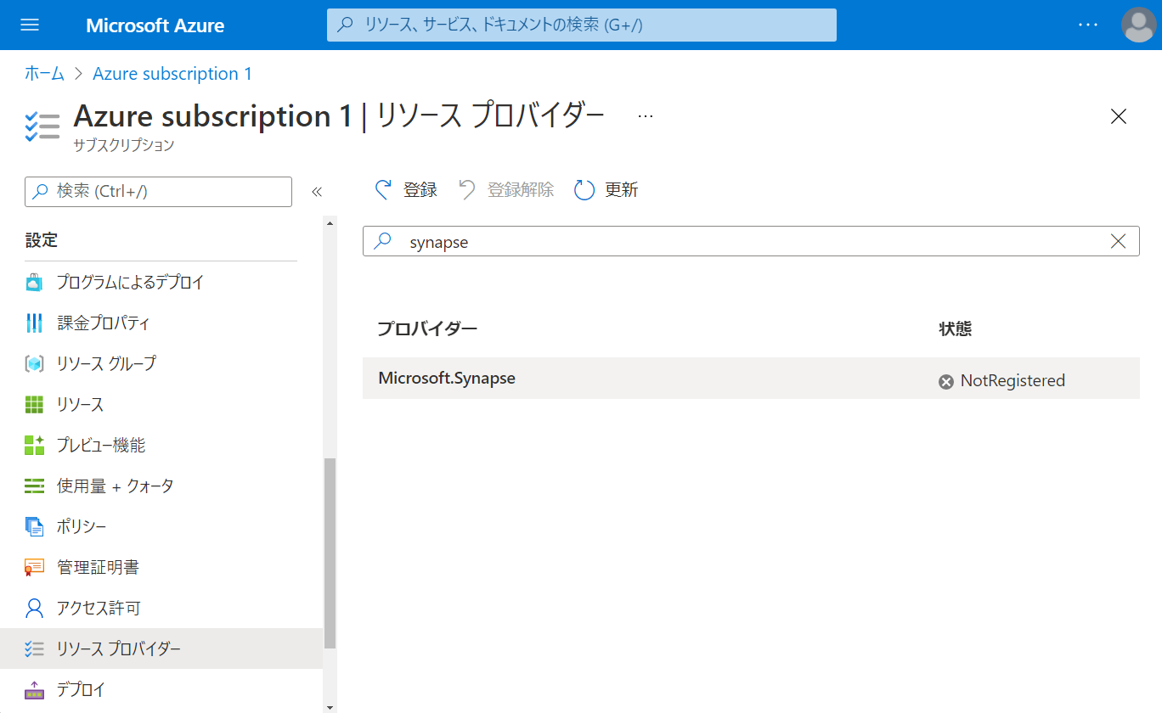

Slide 25
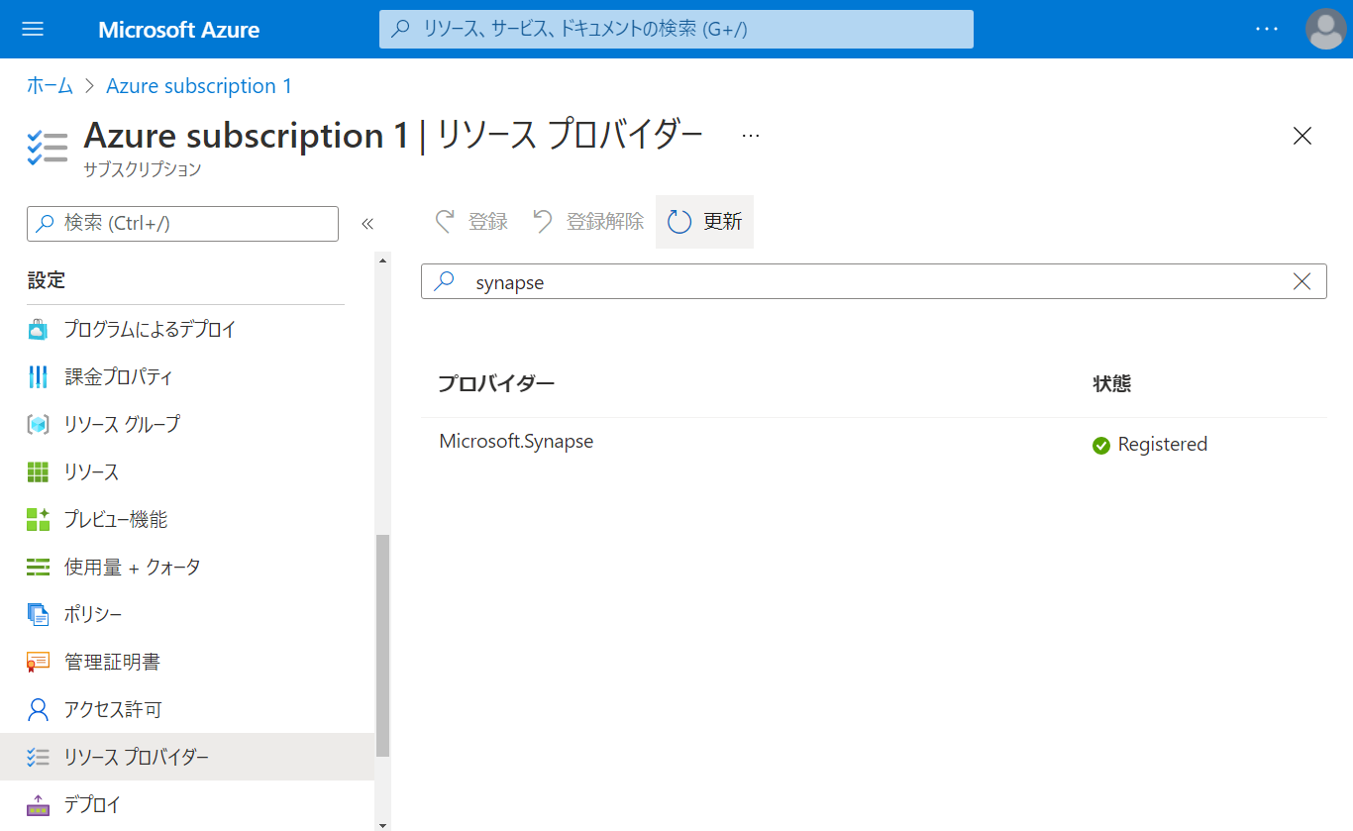

Slide 26
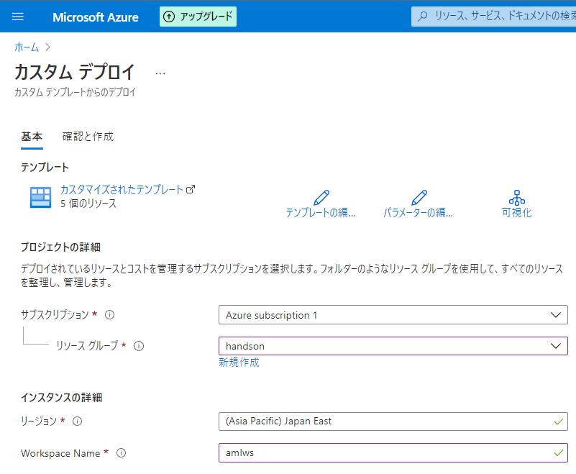

Slide 27
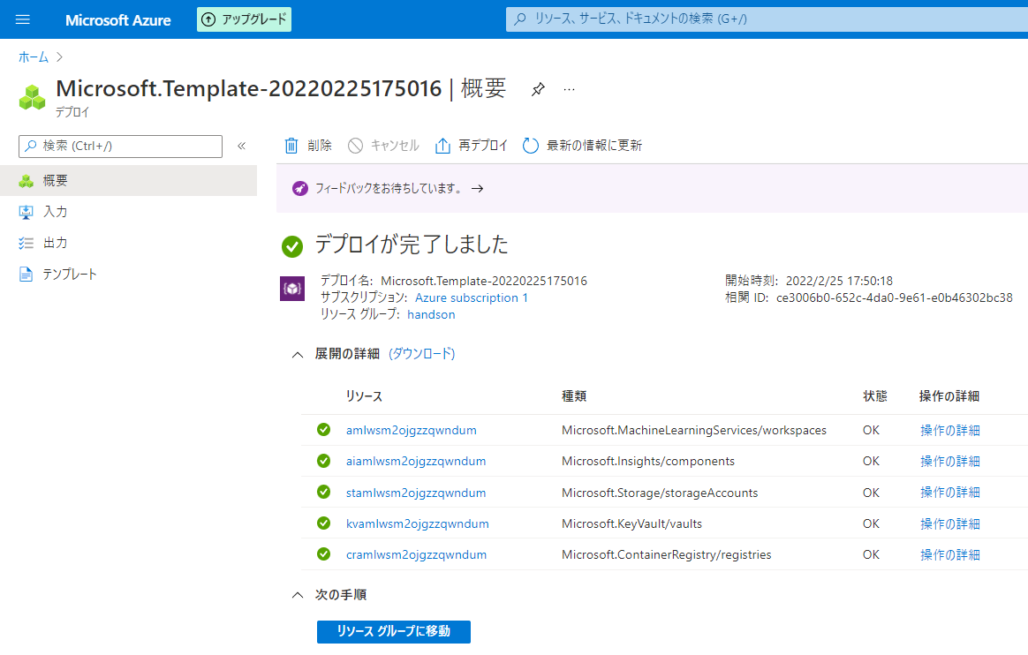

Slide 28
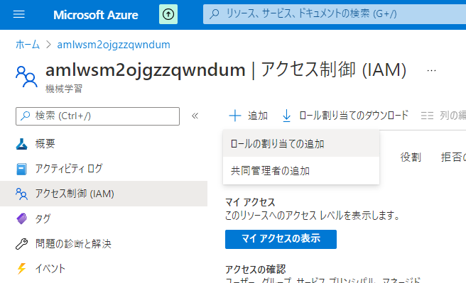

Slide 29
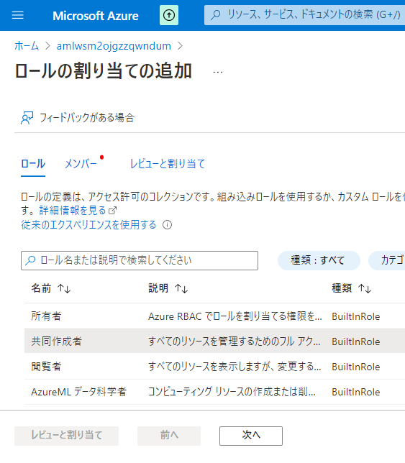

Slide 30
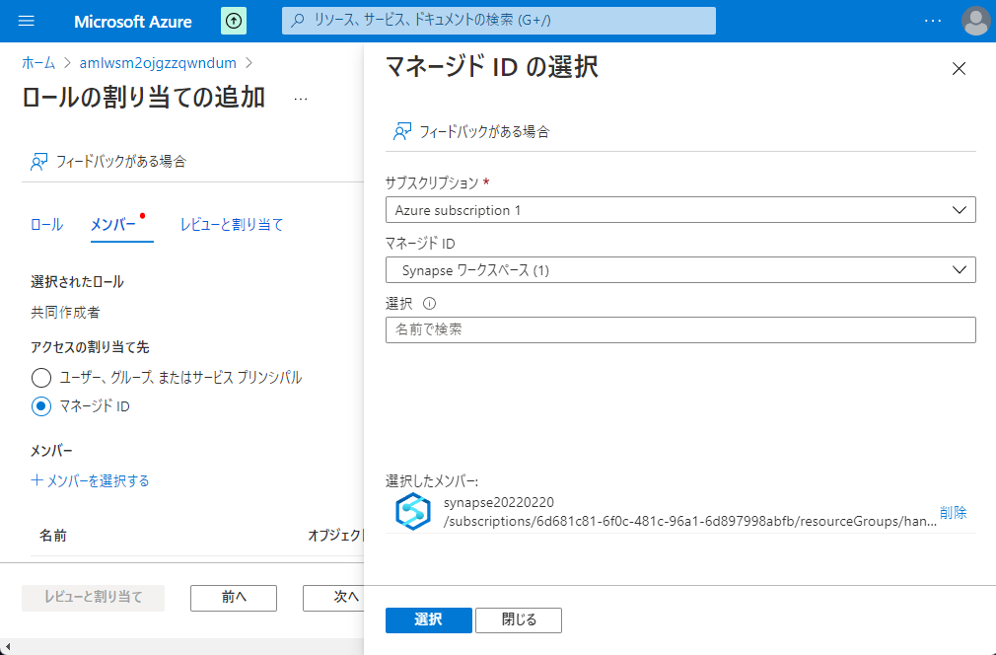

Slide 31
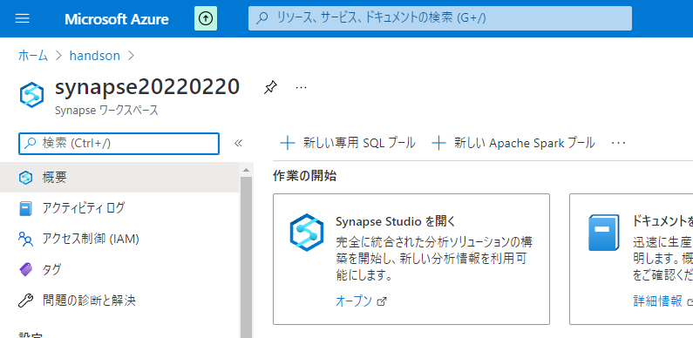

Slide 32
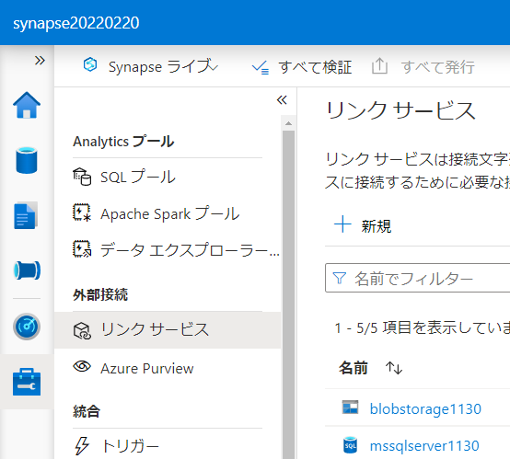

Slide 33
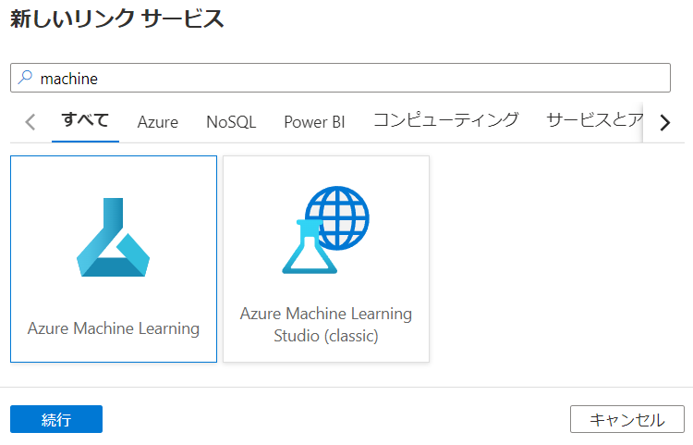

Slide 34
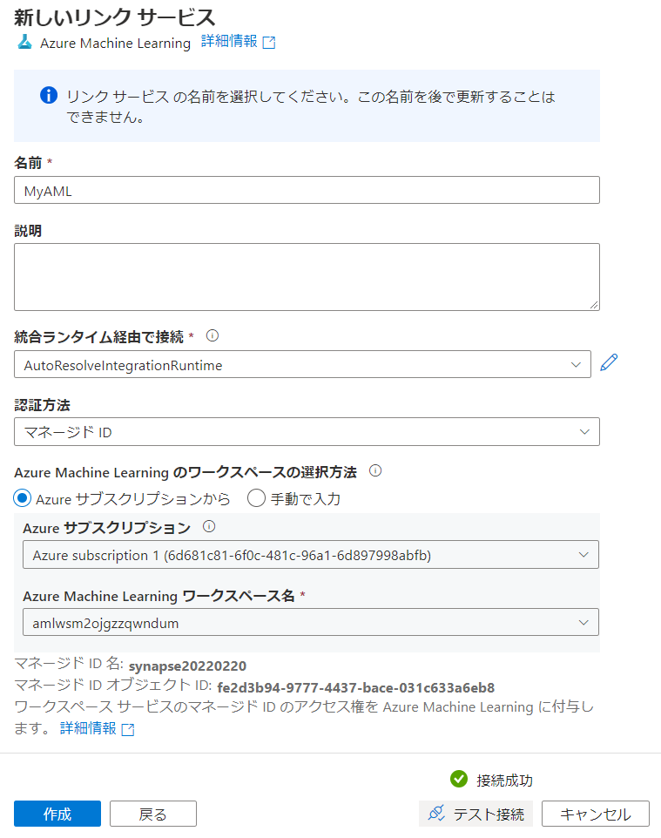

Slide 35
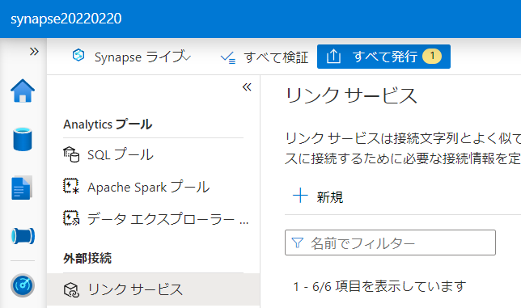

Slide 36
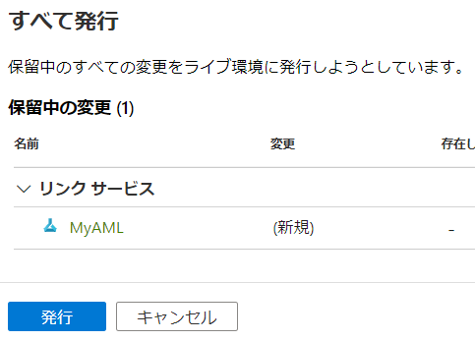

Slide 37
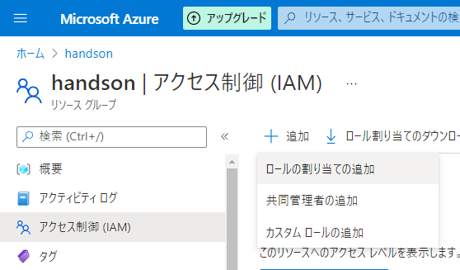
不要

Slide 38
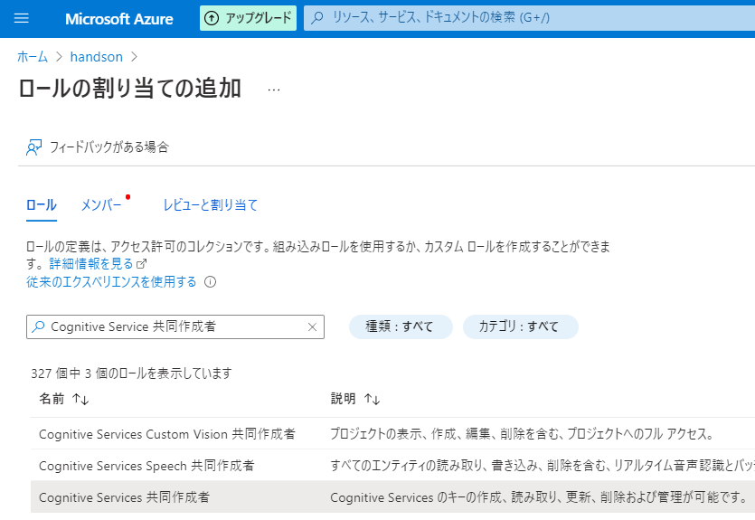
不要

Slide 39
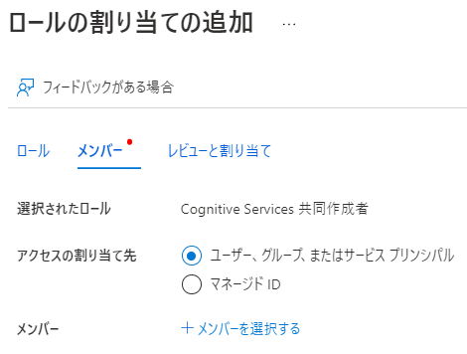
不要

Slide 40
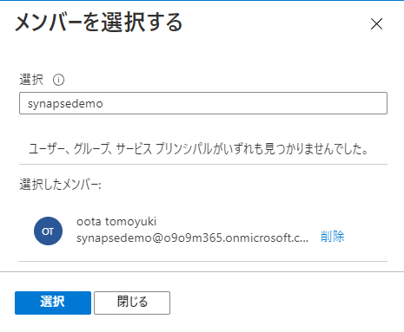
不要

Slide 41
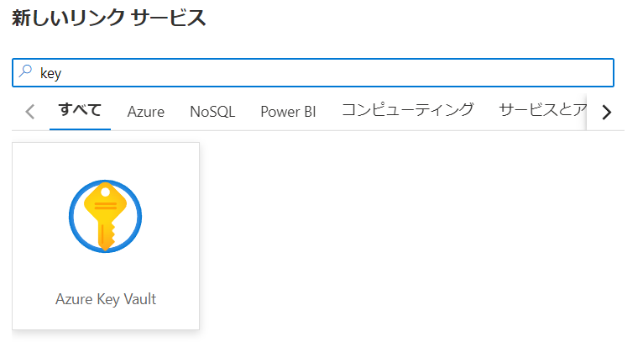

Slide 42
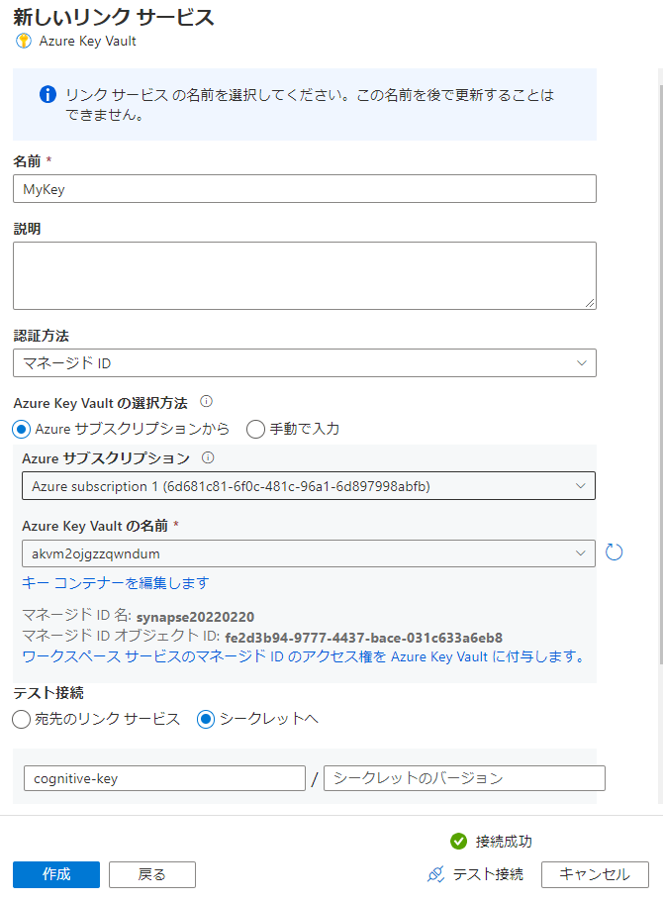

Slide 44
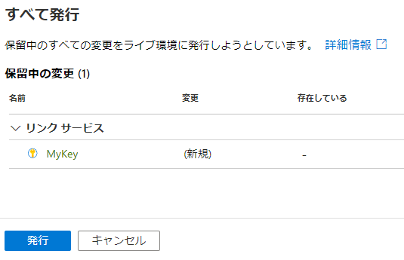

Slide 45
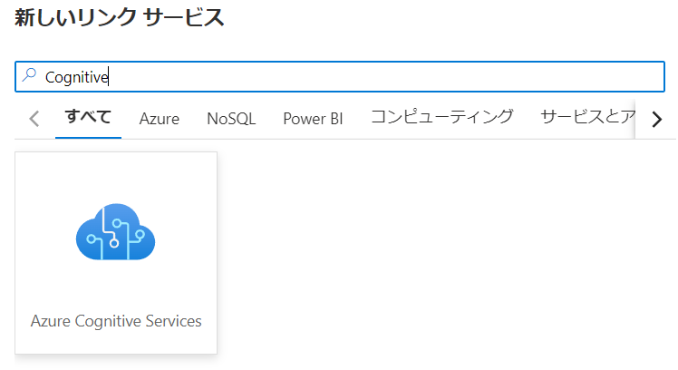


Slide 46
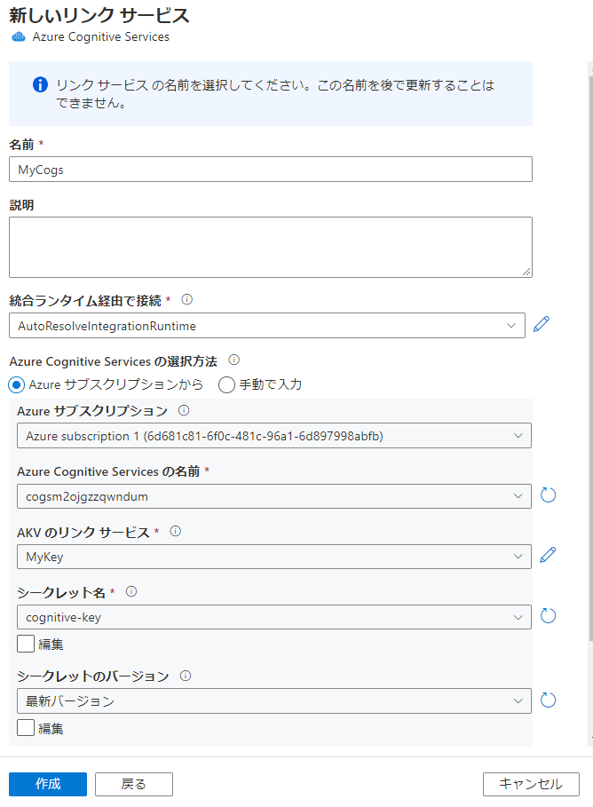

Slide 48
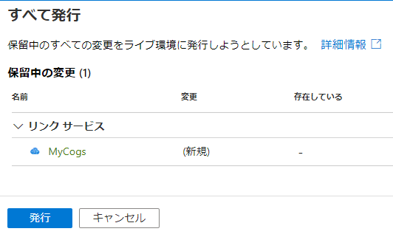

Slide 50
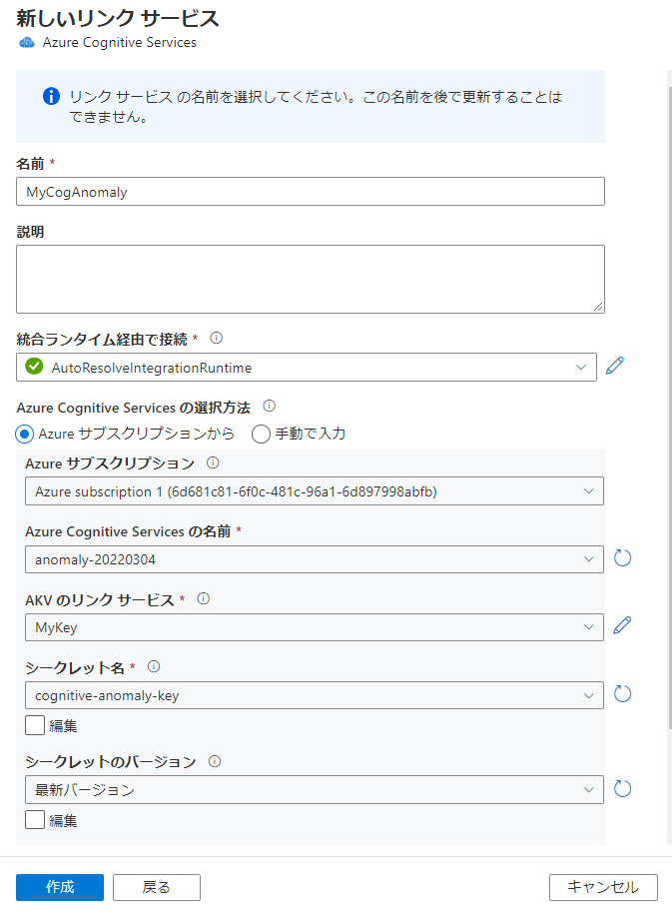

Slide 51


Slide 52
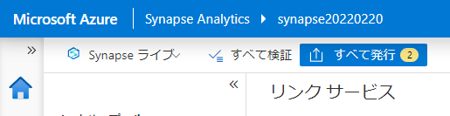

Slide 53
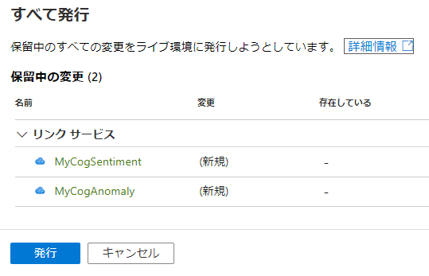

Slide 54
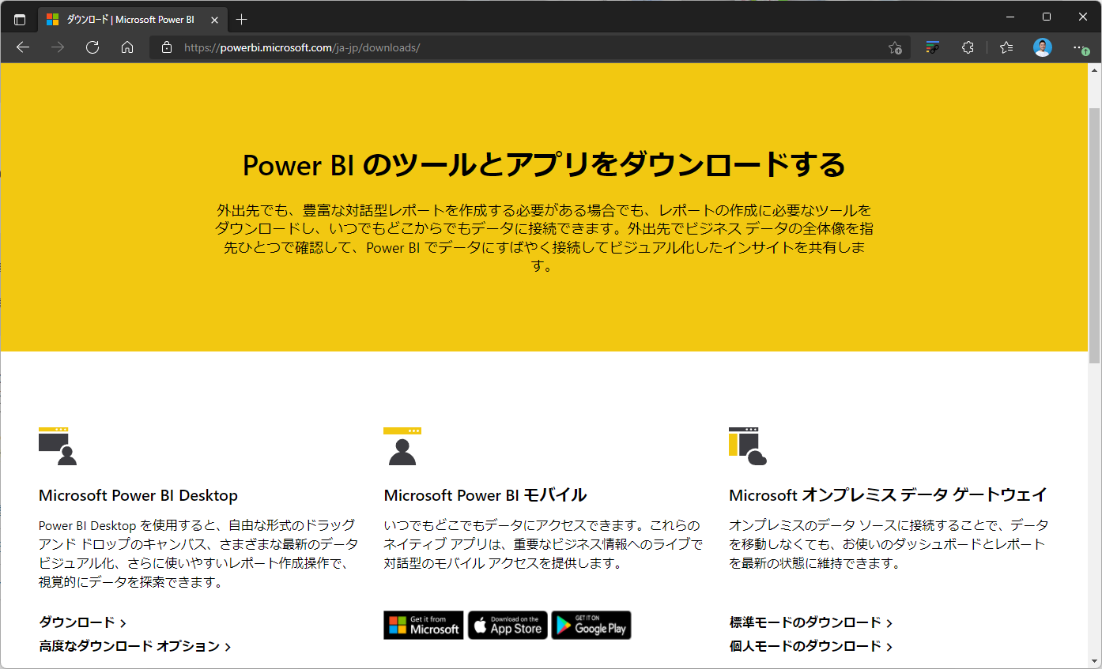

Slide 55
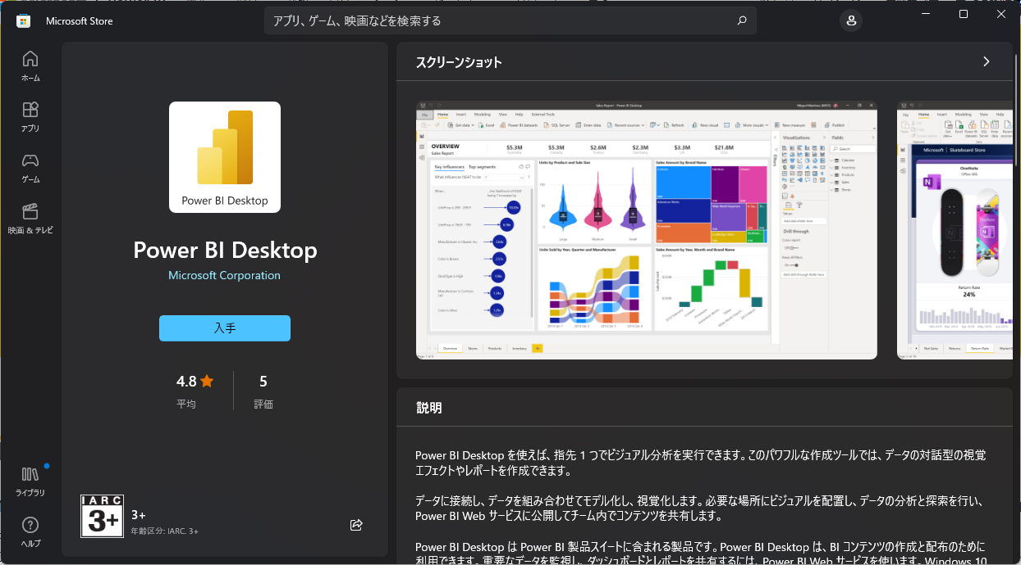

Slide 56
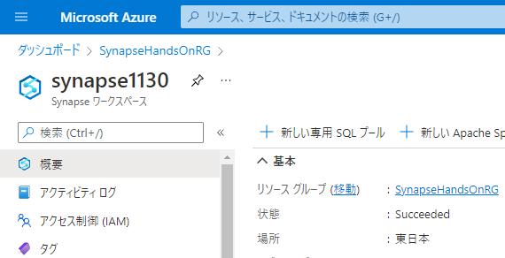

Slide 57
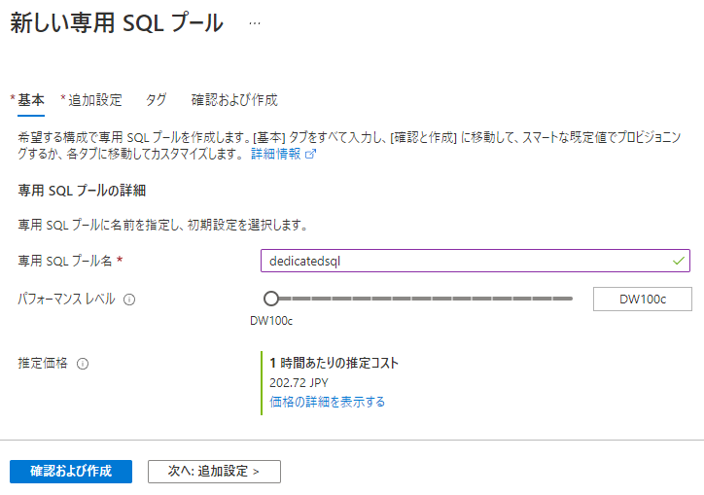

Slide 58
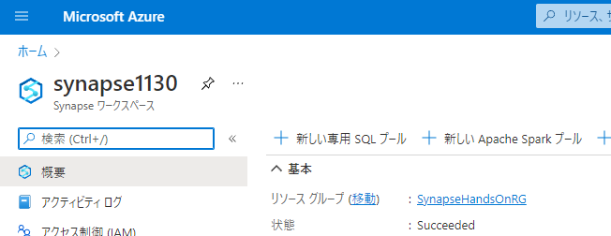

Slide 59
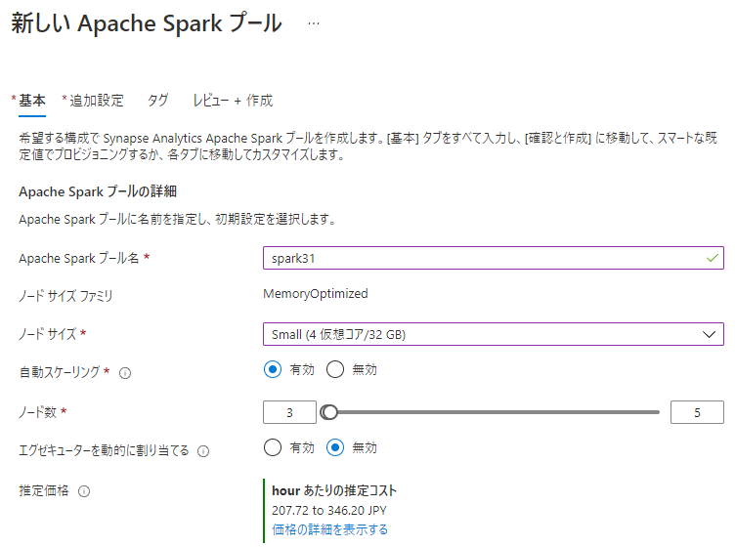

Slide 60
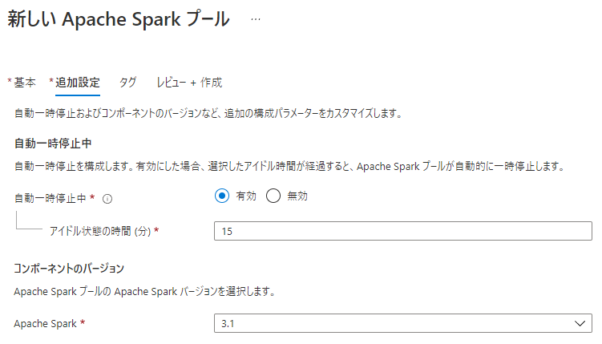

Slide 61


Slide 62


Slide 63


Slide 64


Slide 65


Slide 67


Slide 68


Slide 69


Slide 70


Slide 71


Slide 72


Slide 74


Slide 75


Slide 76


Slide 77


Slide 78


Slide 79

右クリック

Slide 80


Slide 82


Slide 83


Slide 84


Slide 86


Slide 87


Slide 88


Slide 89


Slide 90


Slide 91


Slide 92


Slide 93


Slide 94


Slide 95


Slide 96

ドラッグ&ドロップ

Slide 97

ドラッグ&ドロップ

Slide 98


Slide 99


Slide 100

5-2-2-1

Slide 101

5-2-2-1

Slide 102

5-2-2-2

Slide 103

5-2-2-2

Slide 104

5-2-2-2
右クリック

Slide 105

5-2-2-2

Slide 106

5-3-1-1

Slide 107

5-3-1-1

Slide 108

5-3-1-2

Slide 109

5-3-1-2

Slide 110

5-3-1-2

Slide 111

5-3-1-2

Slide 112

5-3-1-2

Slide 113

5-3-1-2

Slide 114

5-3-1-2

Slide 115

5-3-1-2

Slide 116

5-3-1-2

Slide 117

5-3-1-2

Slide 118

5-3-1-2

Slide 119

5-3-1-2
Column Name | Expression
PickUpDate | toDate(tpep_pickup_datetime,'yyyy-MM-dd')
PickUpLocationID | toInteger(PULocationID)
PassengerCount | toInteger(passenger_count)
DistanceTravelled | toDecimal(trip_distance)
TipAmount | toDecimal(tip_amount)
FareAmount | toDecimal(fare_amount)
TotalAmount | toDecimal(total_amount)

Slide 120

5-3-1-2

Slide 121

5-3-1-2

Slide 122

5-3-1-2
- Join Settings > Output stream name: JoinPickUpLocation - Join Settings > Left stream: TransformColumns - Join Settings > Right stream: TaxiLocationLookup - Join Settings > Join type: Inner - Join Settings > Join conditions > Left: PickUpLocationID - Join Settings > Join conditions > Right: LocationID

Slide 123

5-3-1-2

Slide 124

5-3-1-2
PickUpDate
PaymentType
Borough
Zone

Slide 125

5-3-1-2
Column Name | Expression
TotalTripCount | count()
TotalPassengerCount | sum(PassengerCount)
TotalDistanceTravelled | sum(DistanceTravelled)
TotalTipAmount | sum(TipAmount)
TotalFareAmount | sum(FareAmount)
TotalTripAmount | sum(TotalAmount)

Slide 126

5-3-1-2

Slide 127

5-3-1-2
Borough to PickUpBorough
Zone to PickUpZone

Slide 128

5-3-1-2

Slide 129

5-3-1-2

Slide 130

5-3-1-2

Slide 131

5-3-1-2

Slide 132

5-3-2-1
ドラッグ&ドロップ

Slide 133

5-3-2-2

Slide 134


5-3-2-3

Slide 135

5-3-2-4

Slide 136

5-3-2-4

Slide 137

5-3-2-5

Slide 138

5-3-2-6

Slide 139

5-3-2-6
右クリック

Slide 140

5-3-2-6

Slide 141


Slide 142


Slide 143


Slide 144


Slide 145


Slide 146


Slide 147


Slide 148


Slide 149


Slide 150



Power BI 環境
Synapse Studio からリンクする際にはワークスペースが必要
Power BI Service にログインしてもらいワークスペースを作成してもらう
ライセンスない場合は「無料で試す」から手続きしてもらう

Slide 151


Slide 152


Slide 153


Slide 154




Slide 155


Slide 156





Slide 157


Slide 158


ゲストアカウントをSynapse管理者として登録する方法
IAM追加
StudioからSynapse管理者として登録

Slide 160


Slide 161


Slide 162


Slide 163


Slide 164


Slide 165


Slide 166


Slide 167


Slide 168


Slide 169


Slide 170


Slide 171


Slide 172


Slide 173

コメントアウトを削除

Slide 174


Slide 175

コードをペースト

Slide 176


Slide 177


Slide 178


Slide 179


Slide 180


Slide 181


Slide 182


Slide 183


Slide 184


Slide 185


Slide 186


Slide 187


Slide 188


Slide 189


Slide 190


Slide 191


Slide 192


Slide 193


Slide 194


Slide 195


Slide 196


Slide 197



Slide 198



Slide 199



Slide 200


Slide 201


Slide 202


Slide 203


Slide 204


Slide 205


Slide 206



Slide 207



Slide 208


Slide 209


Slide 210


Slide 211


Slide 213


Slide 216


Slide 217


Slide 218


Slide 219


Slide 220


Slide 221


Slide 222


Slide 223


Slide 224


Slide 225


Slide 226


Slide 227


Slide 228


Slide 229
第8章：リアルタイムデータ分析
Generate
Ingest
Store
Process
Enrich
Serve
Consume
On-Prems / Cloud
Realtime
Stream
Hot Path
IoT Hub
Batch
Functions
Power BI Premium
Dashboard
Event Hubs
Stream Analytics
Un/Semi -Structured
Cognitive Services
Analytics
SQL Database
Relational
Dedicated SQL
Data Explorer
Machine Learning
Cold Path
Dataflow
Cosmos DB
Data-driven Applications
Pipeline
NoSQL
Serverless Spark
Serverless SQL
HTAP with Synapse Link
Data Lake
Data Share
Shared Datasets
Discover & Govern
Azure Purview
Azure Active Directory
Azure Cost Management
Azure Key Vault
Azure Security Center
Platform
Azure Monitor
Azure DevOps
GitHub
Azure Policy

Slide 230


Slide 231


Slide 232


Slide 233


Slide 234


Slide 235


Slide 236


Slide 237


Slide 238


Slide 239


Slide 240


Slide 241


Slide 242


Slide 243


Slide 244


Slide 245


Slide 246



Slide 247


Slide 248


Slide 249


Slide 250


Slide 251


Slide 252


Slide 253


Slide 254


Slide 255


Slide 256


Slide 257


Slide 258


Slide 259


Slide 260


Slide 261


Slide 262


Slide 263


Slide 264


Slide 265


Slide 266


Slide 267


Slide 268


Slide 269


Slide 270


Slide 271


Slide 272


Slide 273


Slide 274


Slide 275


Slide 276


Slide 277


Slide 278


Slide 279


Slide 280


Slide 281


Slide 282


Slide 283


Slide 284


Slide 285


Slide 286


Slide 287


Slide 288


Slide 289


Slide 290


Slide 291


Slide 292


Slide 293


Slide 294


Slide 295


Slide 296


Slide 297


Slide 298


Slide 299


Slide 300


Slide 301


Slide 302


Slide 303


Slide 304


Slide 305


Slide 306


Slide 307


Slide 308


Slide 309


Slide 310


Slide 311


Slide 312


Slide 313


Slide 314


Slide 315


Slide 316


Slide 317


Slide 318


Slide 319



Slide 320


Slide 321


Slide 322


Slide 323


Slide 324


Slide 325


Slide 326


Slide 327


Slide 328


Slide 329


Slide 330
レポートファイルを保存
この時の名前が PBIレポートとデータセットの名前になる

Slide 331


Slide 332


Slide 333


Slide 334


Slide 335


Slide 336


Slide 337

Azure SQL Database with DirectQuery - Power BI | Microsoft Docs

Slide 338


Slide 339


Slide 340


Slide 341


Slide 342


Slide 343


Slide 344


Slide 345


